Slide 1
Research Projects in Computational Studies of Social Phenomena
Midway Presentation

Slide 2
Contents
Theory
Research Question
Hypothesis
Data
Methods
Replication: Sentimental Gender Bias
Valence, Arousal and Dominance (VAD)
Text Complexity
Toxicity
Correlation Analysis

Slide 3
Theory: Toxicity and Sentimental Gender Bias
Sentimental gender bias influences people through traditional gender stereotypes and personal feelings, favoring one gender over the other (Marjanovic et al. 2022)
Glick & Fiske (1996): Benevolent and Hostile Sexism
Pavlopoulos et al. (2020): Toxicity as umbrella term for ‘offensive’, ‘abusive’, and ‘hateful’ language
Implies connection between toxicity and (hostile) sexism
Cheng et al. (2022): Contents of toxic social media posts are often motivated by stereotypical gender biases
Caliskan et al. (2022):
Male-associated words → dominance & female-associated words → valence
Notes:
refresher: complexity and bias appear together?
two steps: validate and build upon
validation: different VAD and differen operationalization toxicity

Slide 4
Theory: Sentimental Gender Bias and Text Complexity
“Machine learning algorithms trained in natural language processing tasks have exhibited various forms of systemic racial and gender biases” (Sharma et al., 2020, p. 1)
Sentimental gender bias is found in NLP tasks such as:
learned word embeddings (Bolukbasi et al., 2016; Brunet et al., 2019)
natural language inference (He et al., 2019a)
hate speech detection (Park et al., 2018)
Toxicity and text complexity:
Kayam (2018): Analysis of Trump’s speeches revealed them to be less complex and easier to read then other politicians
Morzhov (2021): Toxic texts display fewer unique words and ‘less inventive’ use of language
Notes:
NLP: bias is apparent in NLP and this implies that bias has some sort of textual feature. Investigate weather feature is complexity
Morzhov split texts into subclasses: identity attack, toxicity, … and find toxic texts to be less complex

Slide 5
Research Question & Hypotheses
Research Question
How do sentimental gender bias and text complexity appear (together) in Reddit posts?
Hypotheses
H1: Sentimentally gender biased (VAD) Reddit posts about or directed at female US politicians display lower text complexity.
H2: Toxic Reddit posts about or directed at female US politicians display lower text complexity.
H3: Sentimental gender bias operationalized through toxicity and sentimental gender bias operationalized through VAD correlate positively.
Notes:
Can we validate and replicate Marjanovic et al.’s (2022) findings of gender biased Reddit posts towards female US politicians using a two different operationalizations of sentimental gender bias? (1: ANEW VAD - validation; 2: toxicity - replication)

Slide 6
Data
Quantifying gender biases towards politicians on Reddit - Data Set (Marjanovic et al., 2022)
Original data contains over 10 Mio Reddit posts
Sampled due to computational resources (~137k posts)
apply random sample directly for paper replication
post-stratification of sample to adjust for imbalanced group sizes to test hypotheses
Data was gathered to investigate gender bias on Reddit
Key variables include:
content, named_entity, sex, valence, arousal, dominance

Slide 7
Methods: Sentimental Gender Bias
‘When people discuss male and female politicians, do they express equal sentiment and power levels in the words chosen?’
Sentimental gender bias is operationalized through VAD: Valence, Arousal, Dominance
VAD NCR lexicon: 20.000 entries with scores for valence, arousal and dominance → compute average score per post
Authors: Version 2018 → Our Replication: Version 2022
Test for significance of variables using t-tests of means → evaluate strength of effects using Cohen’s D

Slide 8
Methods: Valence, Arousal and Dominance
Validate Marjanovic et al. (2022) following Atmaja & Akagi (2019)¹
1. Analyze Reddit posts using a combination of CoreNLP (Manning et al., 2014) and Valence, Arousal, Dominance (VAD) Lexicon derived from Affective norms for English words (ANEW) (Bradley & Lang, 1999)
2. Rerun the analysis performed by Marjanovic et al. using the ANEW VAD scores
t-tests for VAD differences between genders
Cohen’s Delta analysis to gauge effect size of sentimental gender bias
GitHub: bagustris/text-vad

Slide 9
Methods: Text Complexity
Text complexity is evaluated following Kayam (2018):
1. The percentage of complex words
2. The average number of words per sentence (sentence length)
3. The average number of syllables per word
4. The average number of characters per word (word length)
→ Validate sample
Reliability and Validity:
Gunning Fog Index → how many years of education are required?
SMOG
Flesch-Kincaid Readability Score → scaled between 0 (very easy to read) and 100 (very difficult to read)
Notes:
(polysyllables—words which consist of more than three syllables)

Slide 10
Methods: Toxicity
‘When people discuss male and female politicians, do they express equal levels of toxicity in words chosen?’
Toxicity: “A rude, disrespectful, or unreasonable comment that is likely to make people leave a discussion.”
We utilize perspective API to operationalize toxicity:
Models (Transformer CNN, RNN, LSTM) trained on millions of comments from a variety of sources, including comments from online forums such as Wikipedia and The New York Times, across a range of languages (annotated)
Performance on Jigsaw Multilingual Toxic Comments Challenge AUC-ROC [0.87 ; 0.94] (Lees et al., 2022)
Performance on TweetEval dataset macro F1: [0.53; 0.57] (Lees et al., 2022)
Performance on CivilComments-WILDS dataset Avg. Accuracy: [0.89 ; 0.94] (Lees et al., 2022)
Performance on English-only HatemojiCheck Accuracy: 90.8%, F1: [0.89 ; 0.93] (Lees et al., 2022)

Slide 11
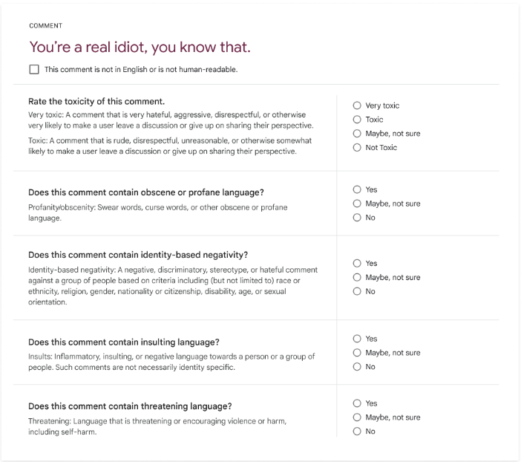
Methods: Toxicity
https://developers.perspectiveapi.com/s/about-the-api-training-data?language=en_US

Slide 12
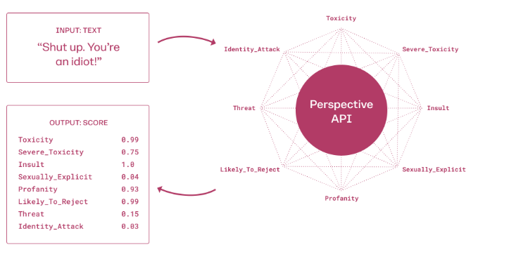
Methods: Toxicity
probability score between 0 and 1
higher score indicates a greater likelihood that a reader would perceive the comment as containing the given attribute
less effective in finding nuanced Misogynoir (Kwarteng et al. 2022)
might change as model gets updated
https://developers.perspectiveapi.com/s/about-the-api?language=en_US

Slide 13
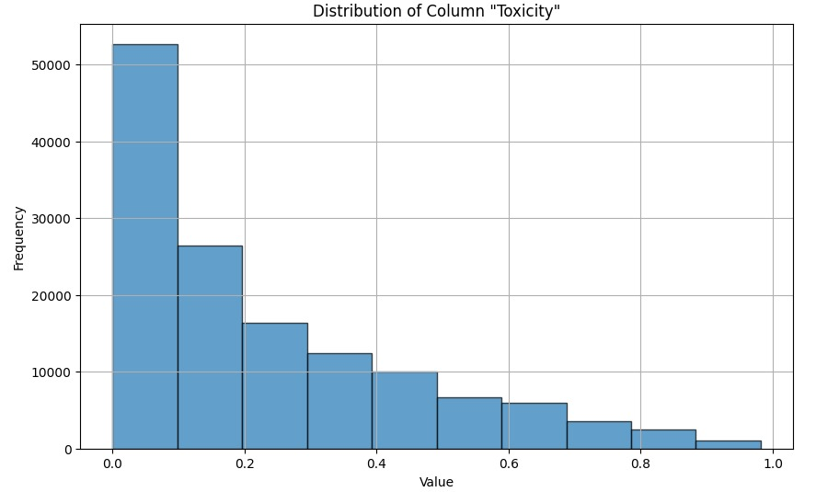
Methods: Toxicity
Check if operationalization are normally distributed:
Validate sample
Test for significance of variables using log transformation and t-tests or Mann-Whitney U Test
Bootstrapping (differences in means)
Cohen’s Delta analysis to gauge effect size of toxicity gender bias (t-test)

Slide 14
Methods: Correlation Analysis
Correlation Coefficients: Compute correlation coefficients to examine the relationship between gender bias (measured via VAD/toxicity) and readability scores.
Spearman Correlation: Use this if the data does not meet the assumptions of Pearson correlation (normal distributed and linear relation).
Visualization: Scatter plots to show correlation between variables
Bootstrap Correlations: Get Confidence Intervals to see how stable the results are

Slide 15
Open Questions
Validation:
Bimodal NRC VAD values vs. normal distributed ANEW VAD values
NRC Dict from 2022 or 2018 (used in Marjanovic et al., 2022)
Should we use bootstrapped results for paper replication?
Sample:
Resample?
Statistical tests:
Enough?!

Slide 16
References
Atmaja, B. T. & Akagi, M. 2019. Deep Learning-based Categorical and Dimensional Emotion Recognition for Written and Spoken Text. https://doi.org/10.31227/osf.io/fhu29
Bolukbasi, T., Chang, K.-W., Zou, J. Y., Saligrama, V., & Kalai, A. T. (2016). Man is to Computer Programmer as Woman is to Homemaker? Debiasing Word Embeddings. In D. Lee, M. Sugiyama, U. Luxburg, I. Guyon, & R. Garnett (Eds.), Advances in Neural Information Processing Systems (Vol. 29). Curran Associates, Inc. https://proceedings.neurips.cc/paper_files/paper/2016/file/a486cd07e4ac3d270571622f4f316ec5-Paper.pdf
Bradley, M. M. & Lang, P. J. 1999. Affective norms for English words (ANEW): Instruction manual and affective ratings. Vol. 30, no. 1. Technical report C-1, the center for research in psychophysiology, University of Florida.
Brunet, M.- E., Alkalay-Houlihan, C., Anderson, A., & Zemel, R. (2019). Understanding the Origins of Bias in Word Embeddings. In K. Chaudhuri & R. Salakhutdinov (Eds.), Proceedings of the 36th International Conference on Machine Learning (pp. 803–811, Vol. 97). PMLR. https://proceedings.mlr.press/v97/brunet19a.html
Caliskan, A., Ajay, P. P., Charlesworth, T., Wolfe, R., & Banaji, M. R. 2022. Gender Bias in Word Embeddings: A Comprehensive Analysis of Frequency, Syntax, and Semantics. Proceedings of the 2022 AAAI/ACM Conference on AI, Ethics, and Society,156–170. https://doi.org/10.1145/3514094.3534162
Cheng, L., Mosallanezhad, A., Silva, Y. N., Hall, D. L., & Liu, H. 2022. Bias Mitigation for Toxicity Detection via Sequential Decisions. Proceedings of the 45th International ACM SIGIR Conference on Research and Development in Information Retrieval, 1750– 1760. https://doi.org/10.1145/3477495.3531945
Glick, P., & Fiske, S. T. 1996. The Ambivalent Sexism Inventory: Differentiating hostile and benevolent sexism. Journal of Personality and Social Psychology, 70(3), 491–512. https://doi.org/10.1037/0022-3514.70.3.491

Slide 17
References II
He, Q., Wang, H., & Zhang, Y. (2020). Enhancing Generalization in Natural Language Inference by Syntax. Findings of the Association for Computational Linguistics: EMNLP 2020, 4973–4978. https://doi.org/10.18653/v1/2020.findings-emnlp.447
Kayam, O. 2018. The Readability and Simplicity of Donald Trump’s Language. Political Studies Review, 16(1), 73–88. https://doi.org/10.1177/1478929917706844
Kwarteng, Joseph, et al. 2022 "Misogynoir: challenges in detecting intersectional hate." Social Network Analysis and Mining 12.1: 166.
Lees, A. et al. 2022. A new generation of perspective api: Efficient multilingual character-level transformers. Proceedings of the 28th ACM SIGKDD conference on knowledge discovery and data mining.
Manning, C. D., Surdeanu, M., Bauer, J., Finkel, J., Bethard, S. J. & McClosky, D. 2014. The Stanford CoreNLP Natural Language Processing Toolkit. Proceedings of the 52nd Annual Meeting of the Association for Computational Linguistics: System Demonstrations, pp. 55-60.
Marjanovic, S., Stańczak, K. & Augenstein, I. 2022. Quantifying gender biases towards politicians on Reddit. PLoS ONE 17(10): e0274317. https://doi.org/10.1371/journal.pone.0274317
Morzhov, S. V. (2021). Modern Approaches to Detecting and Classifying Toxic Comments Using Neural Networks. Automatic Control and Computer Sciences, 55(7), 607–616. https://doi.org/10.3103/S0146411621070117
Pavlopoulos J., Sorensen J., Dixon L., Thain N., & Androutsopoulos, I. 2020. Toxicity Detection: Does Context Really Matter?. arXiv. https://doi.org/10.48550/arXiv.2006.00998
Sharma, S., Dey, M., & Sinha, K. (2021). Evaluating Gender Bias in Natural Language Inference [Version Number: 1]. https://doi.org/10.48550/ARXIV.2105.05541

